Slide 1
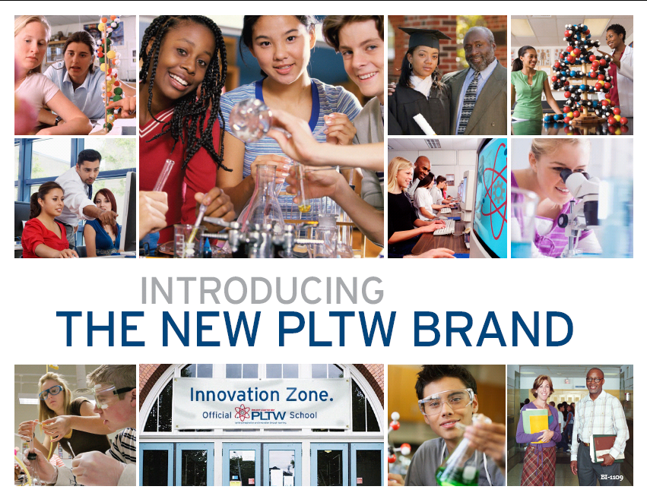
Preparing Students for
High-Wage, High Demand
JOBS

Slide 2
Focusing Education on the Future Welcome and Introductions - Rendee Dore’, San Jose State University, PLTW Center - Linda Christopher, LEED, Capital Region PLTW Network PLTW Overview - Duane Crum, PLTW State Leadership, SDSU PLTW Schools - Chris Stinson, Antelope High School Engineering

Slide 3
Introduction to PLTW Duane Crum, PLTW State Leader

Slide 4
This Week’s Local Paper:
…thousands of high-paid jobs…waiting for applicants with the right skills.
…finding these applicants can be a challenge because of the area’s high cost of living…
A survey indicates there are about 6,000 IT job openings in the county … (and) about 2,000 … in mechanical and electrical engineering.

Slide 5
Why Do We Need PLTW?
There are 1.3 M engineering & technology jobs open in the U.S. without trained people to fill them.
According to the Government we will need 15M engineers and tech workers by 2020, but…
Since 1988, the number of Engineering and Technology Graduates has decreased by ~20%.

Slide 6
Why Do We Need the Biomedical Sciences Program?
Prepare students for high demand, high wage careers –healthcare employs>10% of total national employment.
Prepare students for rigorous post-secondary education and training.
Address impending critical shortage of health professionals – over 3.6M new healthcare jobs are expected by 2014 including 8 of 20 of all highest growth jobs.
Notes:
The biomedical sciences comprise one of the largest industries in the United States, employing more than 15 million people working in a wide range of occupations. Over 10% of the national employment is in the healthcare industry. By the year 2014, over 3.6 million new healthcare jobs are expected to be created. Eight of the twenty occupations projected to have the greatest job growth over the next ten years are in healthcare. (U.S. Dept. of Labor, Bureau of Labor Statistics, 2006)

Slide 7
Biomedical Careers --- some examples ---
Physician
Nurse
Dentist
Veterinarian
Pharmacist
Paramedic
Dietician
Surgeon
Research Scientist
Health Information Manager
Medical Technologist
Radiology Technician
Medical Technical Writer
Physicians’ Assistant
Biomedical Engineer
Notes:
Examples of some of the fields students in the Biomedical Sciences Program may want to pursue. This list is far from all inclusive. One common theme about all the careers is the need for two or more years of post-secondary education and training. In some cases, many more than two years of post-secondary education is required.
Most people commonly think of healthcare in terms of hospitals, doctors, nurses, and dentists, but the biomedical sciences are much more varied and extensive. In addition to people who provide direct care and diagnostic services, the field includes those who do biomedical engineering, research disease and human physiology, study nutritional science, are involved in a variety of supporting professions such as, facilities design and management, environmental health and safety, health information management and analysis, industrial hygiene, and those who determine public policy affecting health care delivery, finance, regulation, and community services.
Pharmaceutical manufacturing is the fastest growing manufacturing industry in the U.S. and requires workers to research, develop, manufacture, and supply medicines and other biomedical therapies derived from biotechnology. The United States is the world’s leading developer and producer of modern medicines, and pharmaceuticals are an important American export.

Slide 8
PLTW’s Three Key Components:
Curricula - Rigorous and Relevant middle and high school courses (with college credit options) that use problem-based learning.
Professional Development – High-quality, rigorous, continuing, and course-specific teacher training.
Partnerships – Required relationships between businesses, post-secondary institutions and school administrators.

Slide 9
Students Learn the Soft (Core?) Skills Businesses Want:
Work as a team member
Search and evaluate websites
Cite sources of information
Write summaries
Speak and present in front of multiple audiences
Design experiments
Make data charts and graphs
Notes:
The listed skills are taught, practiced, and reinforced throughout all four courses in the Biomedical Sciences program.
Skills listed:
Work as a team member
Search and evaluate websites
Cite sources of information
Write summaries
Speak and present in front of multiple audiences
Design experiments
Make data charts and graphs

Slide 10
What Can We Do?
Make a small change in the culture of American high schools by:
Strengthening the core academic curricula, (e.g. English, math, science, social studies, etc.)
Adding a rigorous, technical, standards-based program of study in engineering and technology, leading to jobs, trade schools, 2-year, 4-year and post graduate degrees.

Slide 11
What Students (and Teachers) do Well in PLTW? Students who:
Show interest in STEM (Science, Technology, Engineering, or Math) career fields.
Are creative – Like art and design.
Enjoy working with computers.
Learn best in “hands-on” classes.
Are in the upper 80% of their class.

Slide 12
Curriculum Programs

Slide 13
Curriculum Programs
Engineering Programs
Middle School: Gateway To Technology
six, nine-week long modules
High School: Pathway To Engineering
Eight, year-long courses
Biomedical Sciences Program
High School: Biomedical Sciences
Four, year-long courses

Slide 14
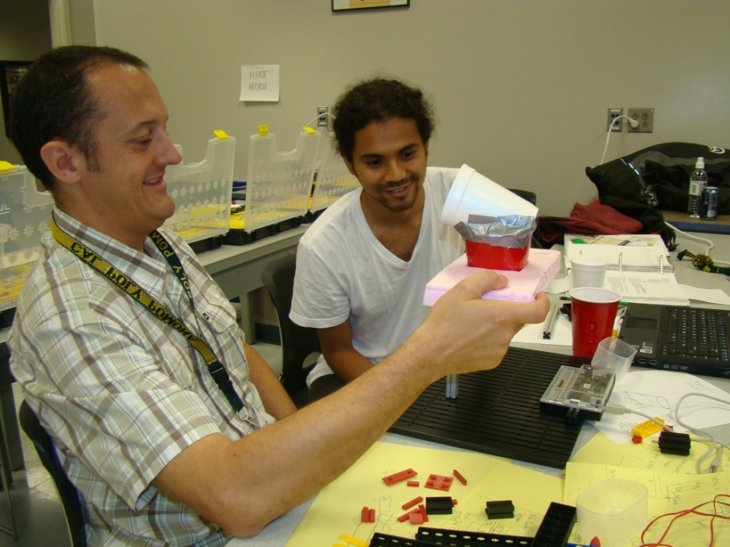
Gateway To Technology for Middle School It’s How we Recruit Boys And Girls.
Basic Units
Design and Modeling
Automation and Robotics
Energy and the Environment
Advanced Units
Flight and Space
Science and Technology
Magic of Electrons

Slide 15
Gateway To Technology Program
All six GTT modules are designed as ten-week units on a standard 50 minute schedule; totals 1.5 academic years of material.
Schools may offer courses from grade six through grade eight in a manner they determine reasonable and appropriate for their school.

Slide 16
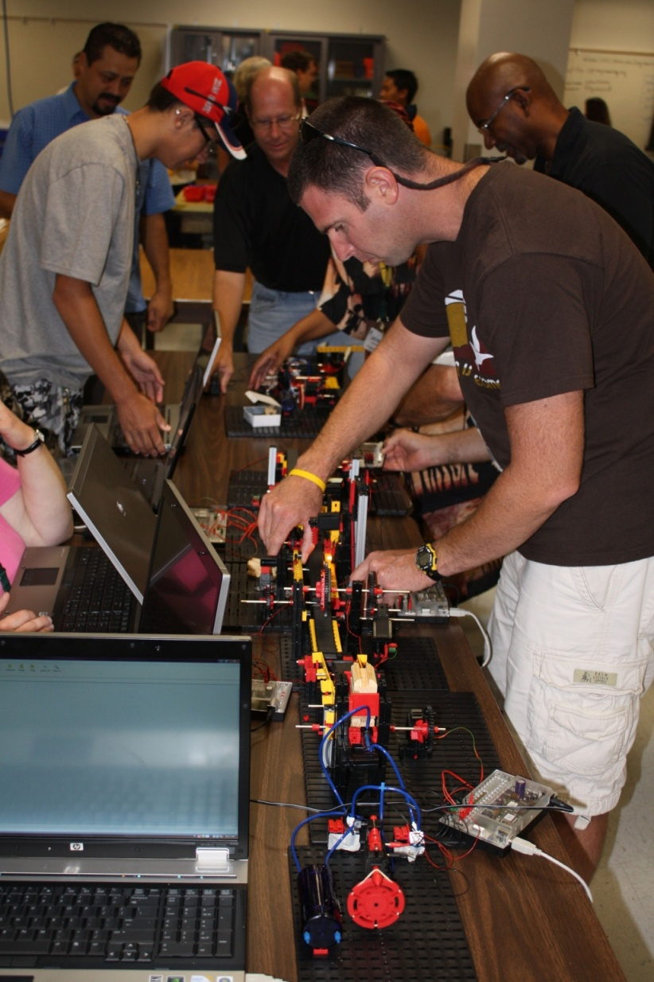
Gateway To Technology Program
Simulated manufacturing line

Slide 17
High School Pathway to Engineering Program
Foundation Courses
Introduction to Engineering Design
Principles Of Engineering
Specialization Courses
Digital Electronics
Aerospace Engineering
Biotechnical Engineering
Civil Engineering and Architecture
Computer Integrated Manufacturing
Capstone Course
Engineering Design and Development

Slide 18
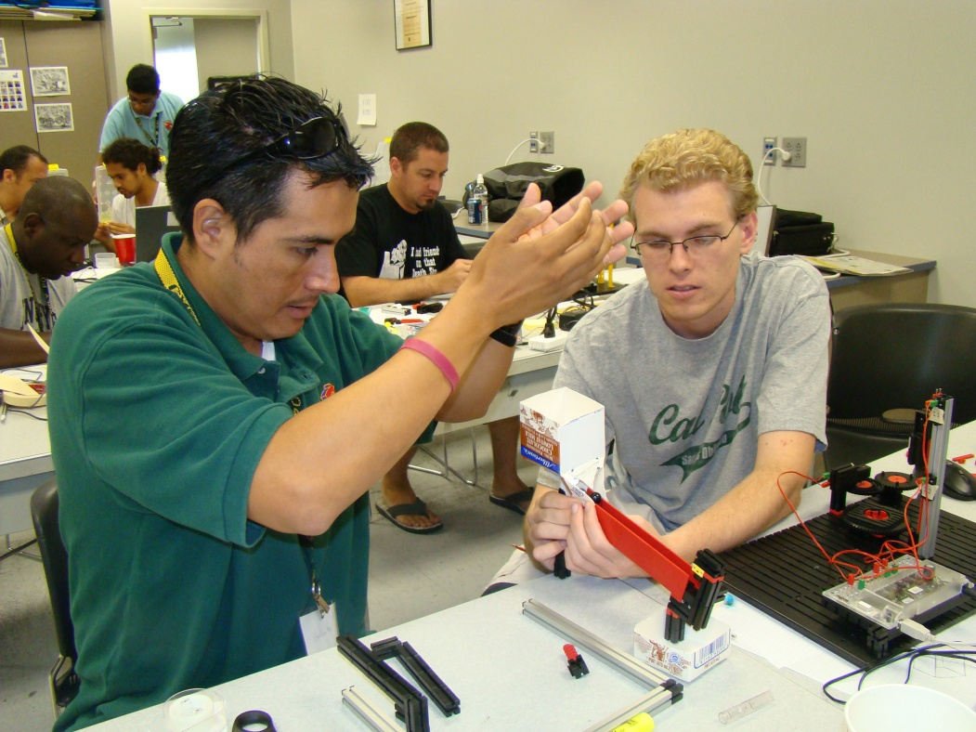
Foundation Course: Principles Of Engineering
A hands-on, project-based course that teaches:
Engineering as a Career
Materials Science
Structural Design
Applied Physics
Automation/Robotics
Embedded Processors
Drafting/Design

Slide 19
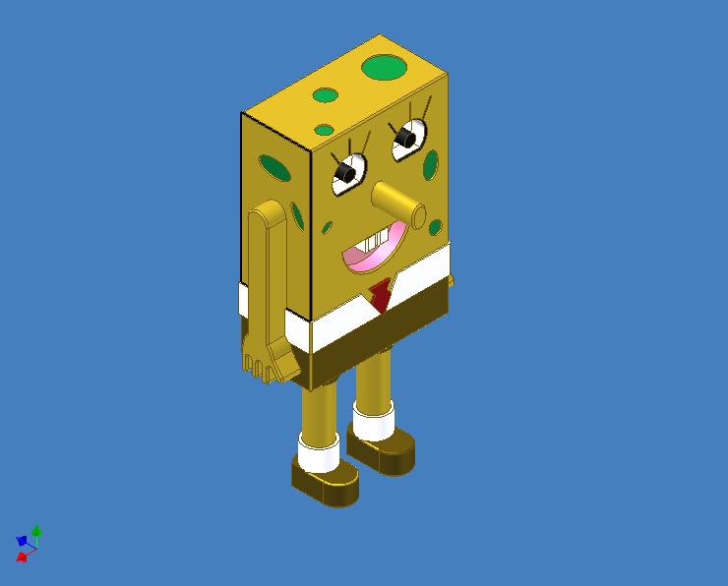
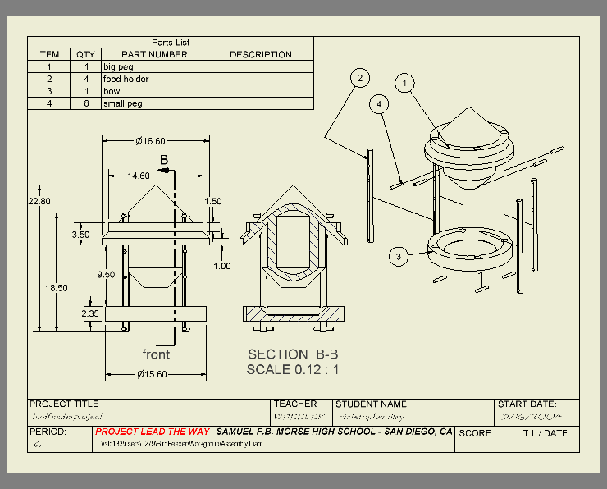
Foundation Course: Introduction To Engineering Design

Slide 20
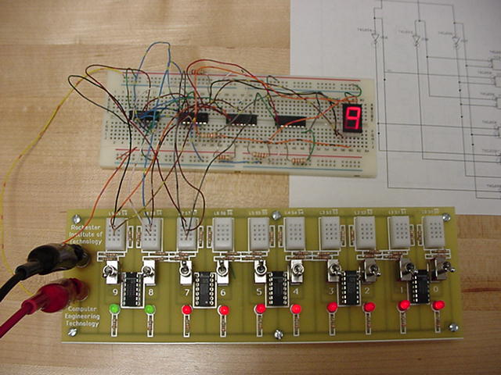
Foundation Course: Digital Electronics
Design > Simulate > Prototype > Fabricate

Slide 21
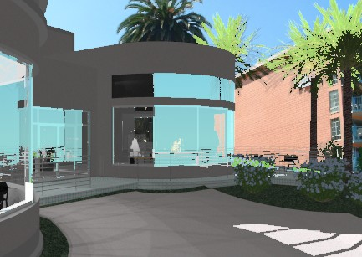
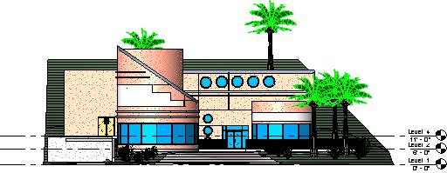
Specialization Course: Civil Engineering and Architecture
Soils
Permits
Design
Structural Analysis
Cuban Restaurant

Slide 22
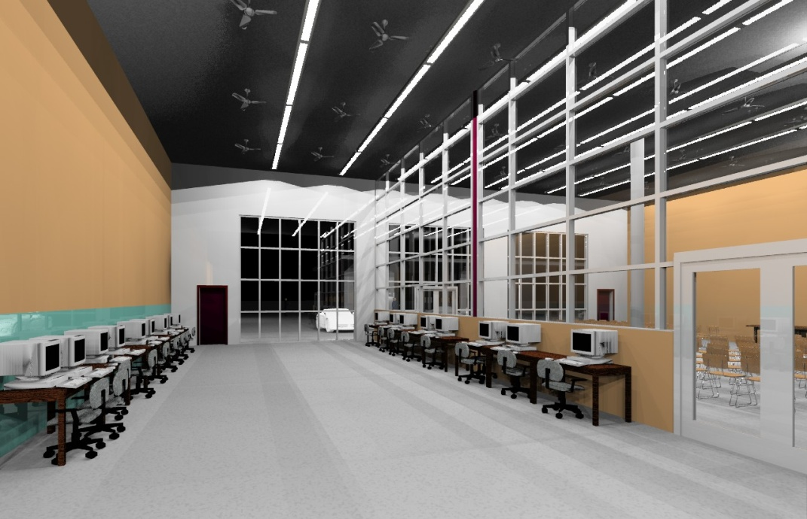
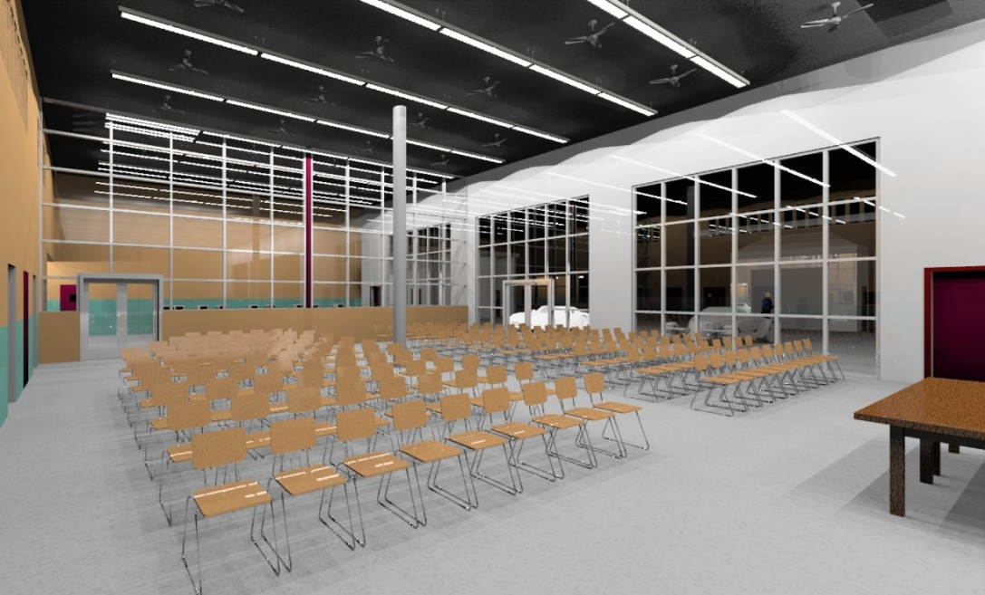
Civil Engineering & Architecture Kearny Redesigns Their Classroom

Slide 23
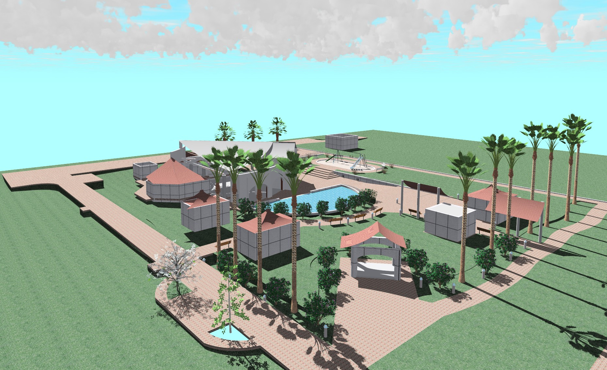
And a Neighborhood Park

Slide 24
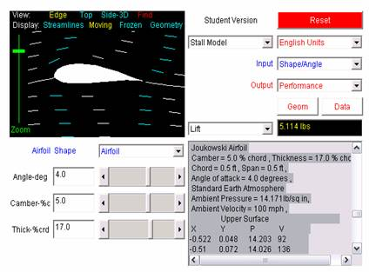
Aerospace Engineering
Example Project:
Design and build an airfoil.
Test it in a wind tunnel.
Compare to theory
Create a 3D solid model of the airfoil in AutoDesk Inventor.

Slide 25
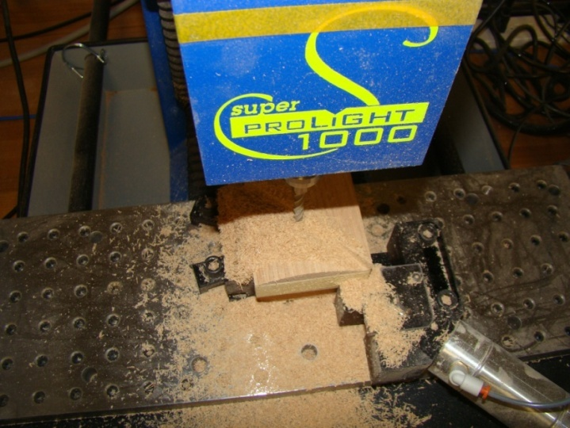
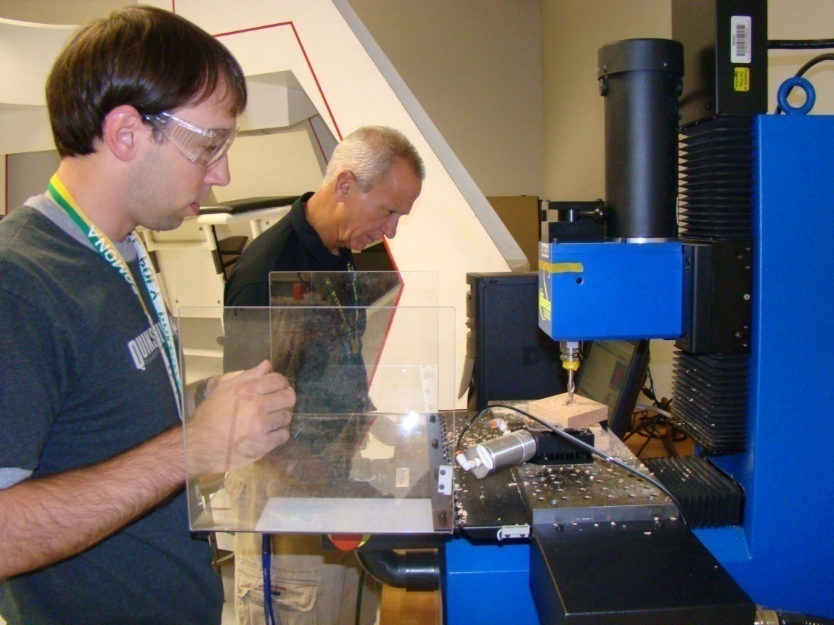
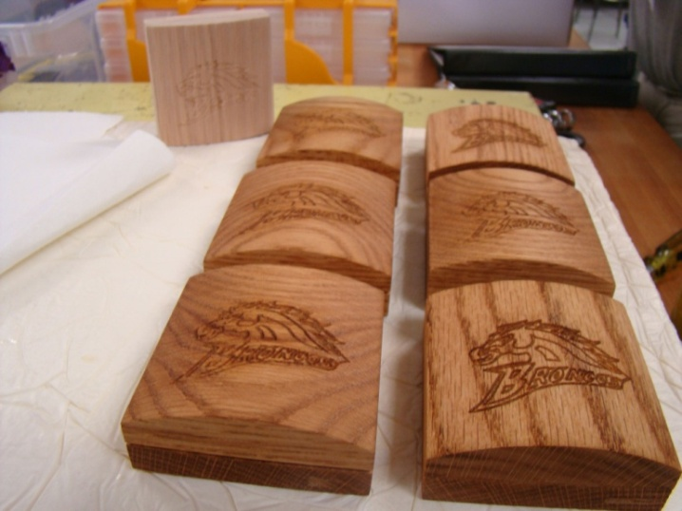
Specialization Course: Computer Integrated Manufacturing

Slide 26
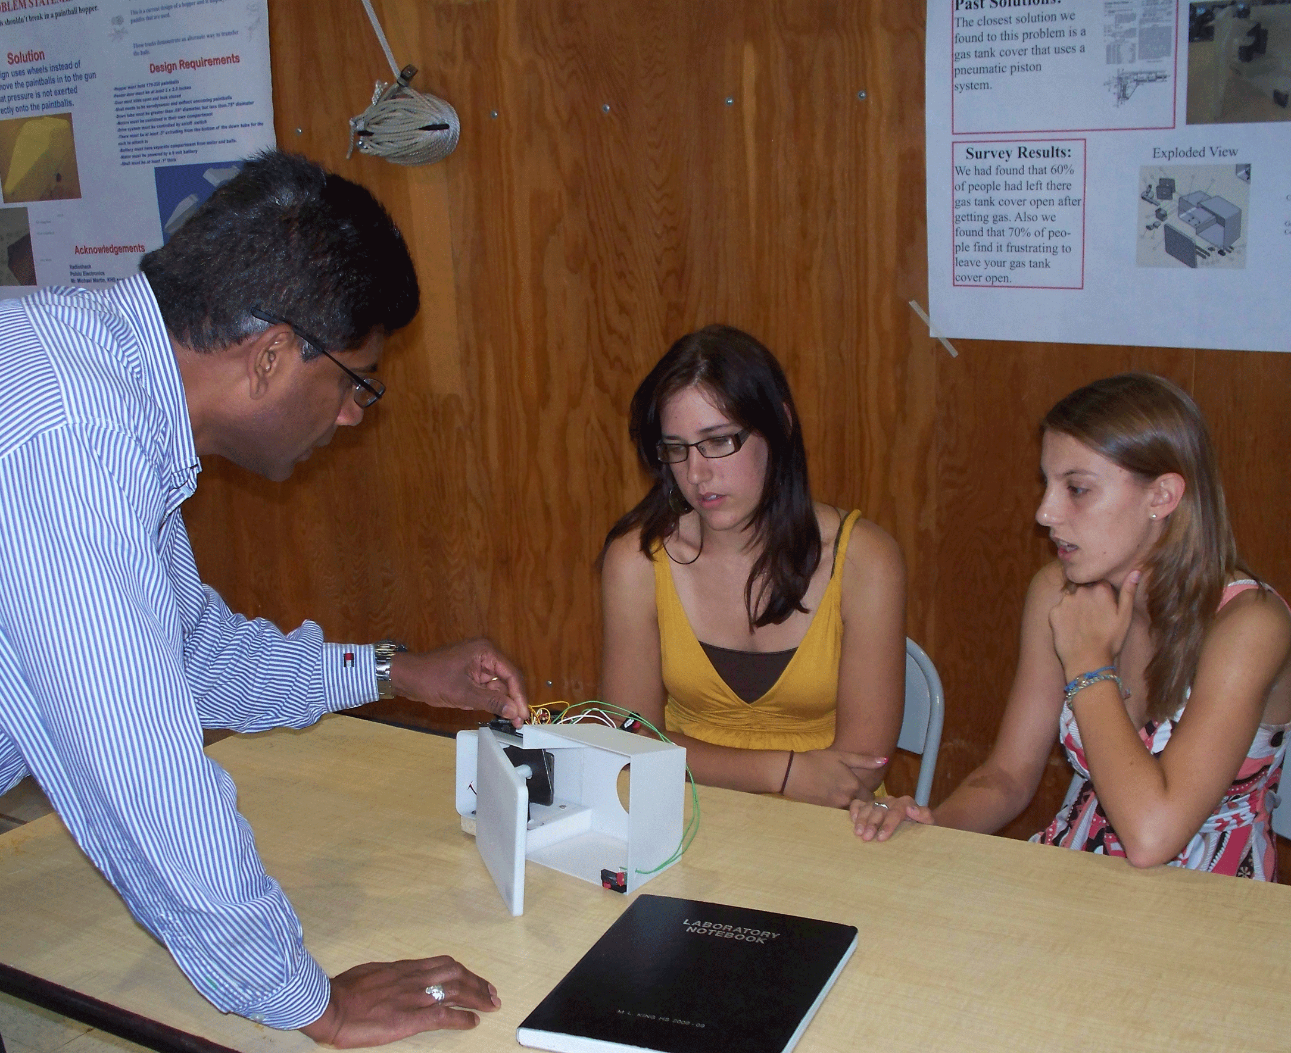
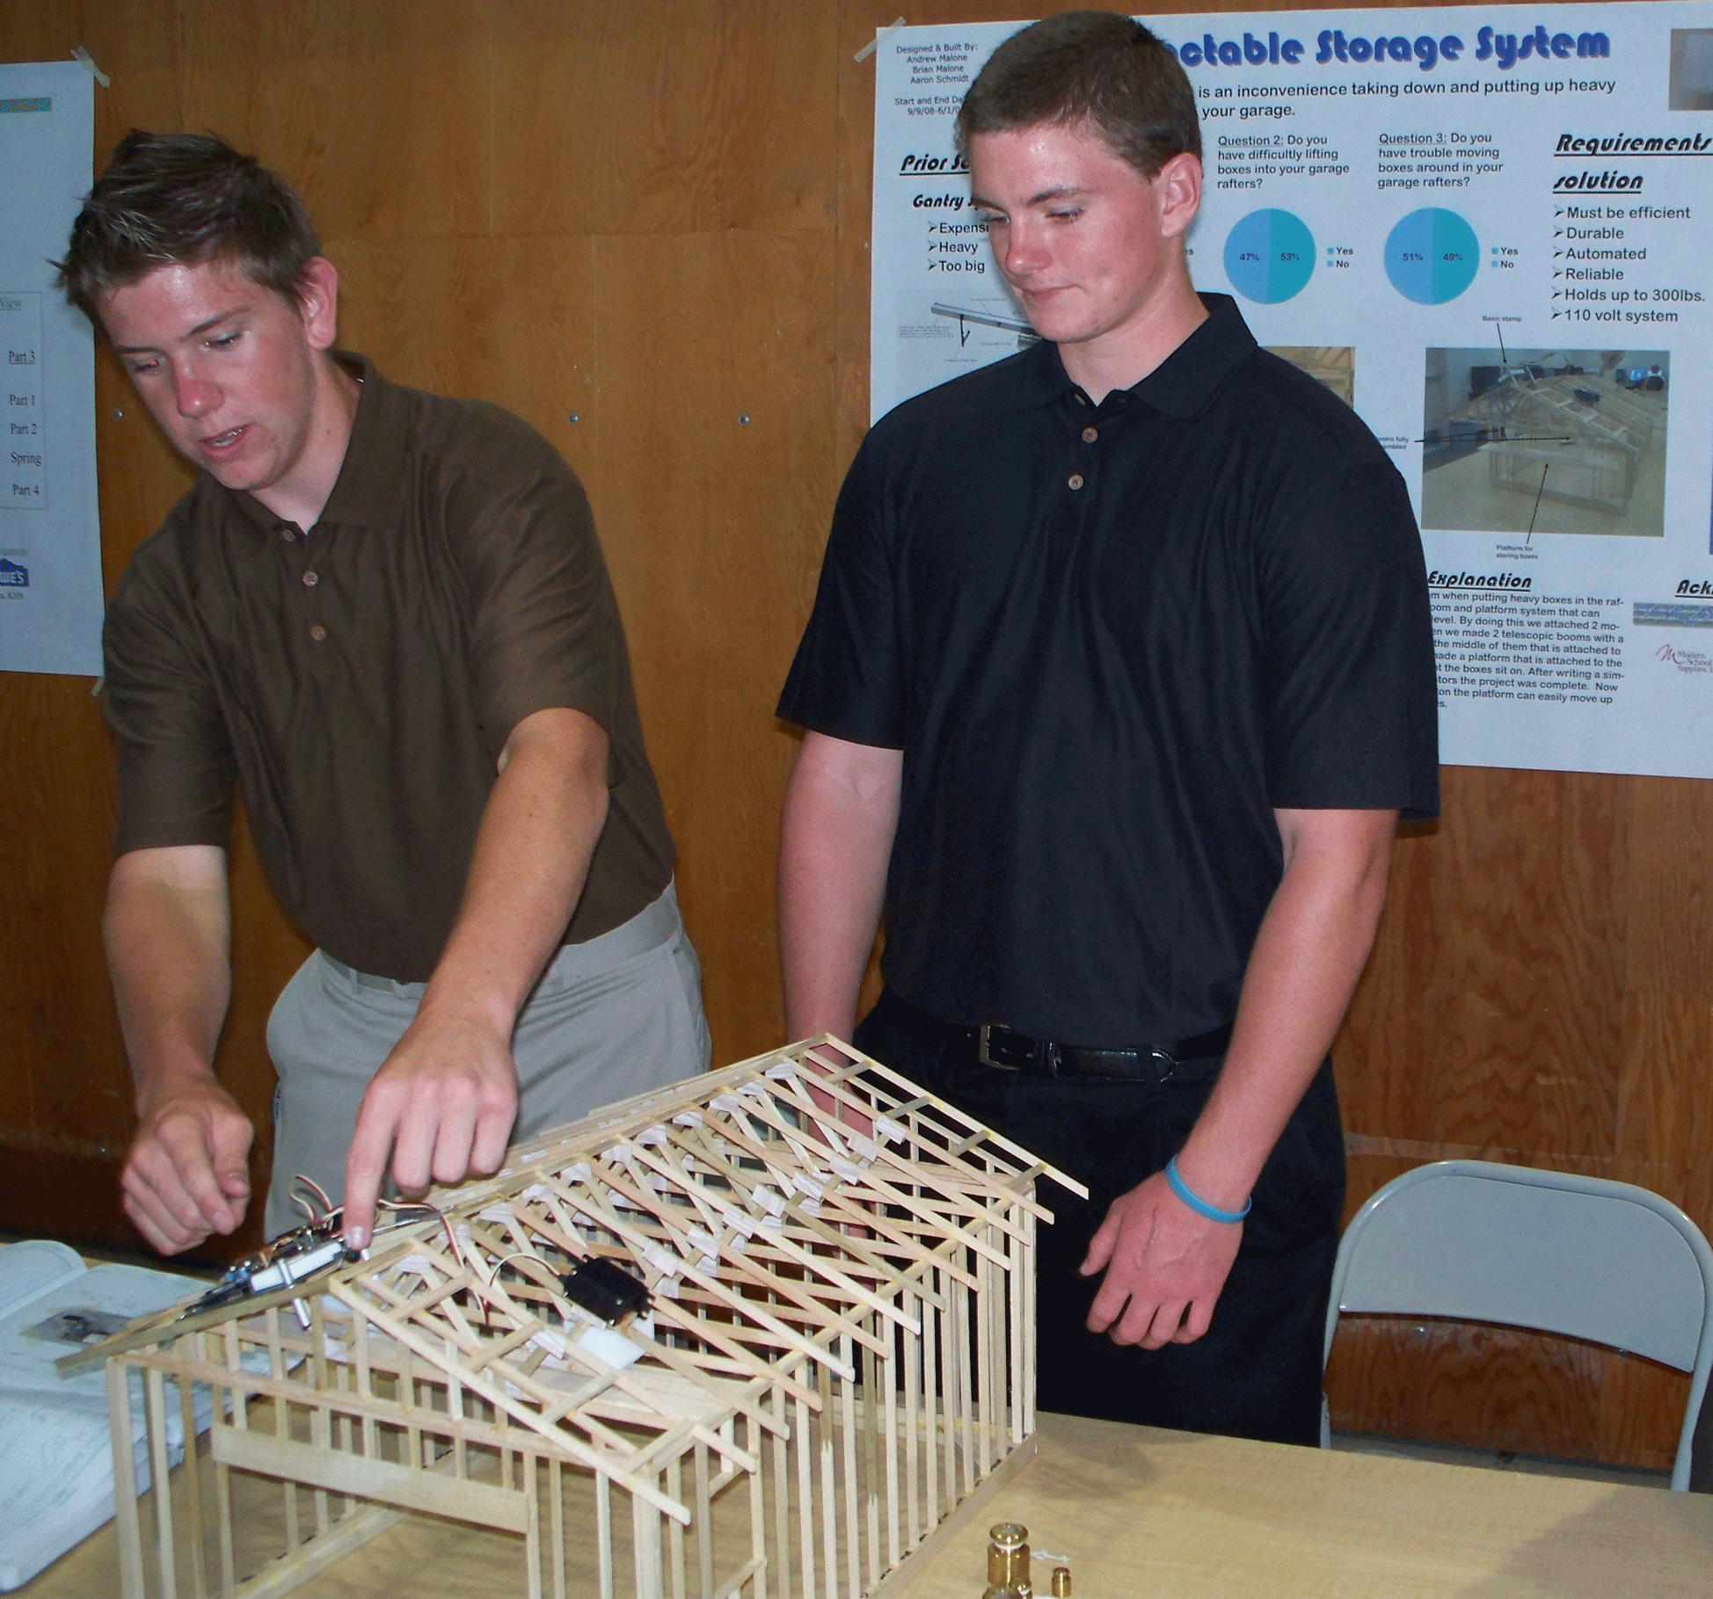
Capstone Course: Engineering Design and Development
Problem Solving in Teams
Juried Presentations

Slide 27
BIOMEDICAL SCIENCES PROGRAM

Slide 28
Biomedical Sciences Program
Sequence of Four Courses:
Principles of the Biomedical Sciences
Human Body Systems
Medical Interventions
Biomedical Innovation
Note: Students are expected to take a complete program of college-prep science and mathematics.
Notes:
The Biomedical Sciences Program is a sequence of four courses. Each course builds on the skills and knowledge students gained in the proceeding courses. This is unlike the Engineering Program that uses a Foundation and Specialization format and does not require students to take the foundation courses in any particular sequence. Although the program is designed to be a sequence with students taking one course each year of high school, students can take two consecutive courses simultaneously in their later years in high school. For example a student could begin the program as junior and take both the Principles of the Biomedical Sciences and the Human Body Systems courses; then as a senior take both Medical Interventions and Biomedical Innovation.

Slide 29
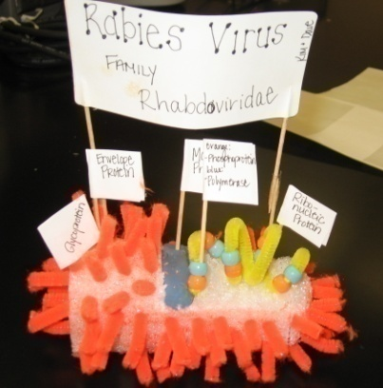
Course #1: Principles of the Biomedical Sciences
The study of human medicine, research processes and an introduction to bioinformatics.
Students investigate human body systems and health conditions including: heart disease, diabetes, sickle-cell disease, hypercholesterolemia, and infectious diseases.
Notes:
The first course, Principles of the Biomedical Sciences™, lays the foundation for the subsequent courses. It is also the engagement course designed to introduce students to the broad field of biomedical science. There are no pre-requisite courses for this first course, and students do not need to have had a high school biology course. The biology concepts necessary for success in the course are embedded within the curriculum. Students can take this course in 9th grade, or depending on how the school implements the program they may take it in the later grades. Even 12th graders can take the course if they decide late in high school that they are interested in the biomedical sciences. Students taking any of the other courses in the Project Lead The Way® Biomedical Sciences Program, must take this course prior to, or concurrent to, their enrollment in those courses.
In this course students investigate the major biological concepts by studying various disease conditions. For example, students learn about the importance of homeostasis, feedback mechanisms, and metabolism by investigating diabetes; they learn about genetics and DNA by investigating sickle-cell disease. In this course students use Vernier® probes and the LabVIEW™ software to take various heart measurements, including EKG, blood pressure, and heart rate. They perform DNA gel electrophoresis, Gram stain bacteria, and prepare and present a grant proposal.

Slide 30
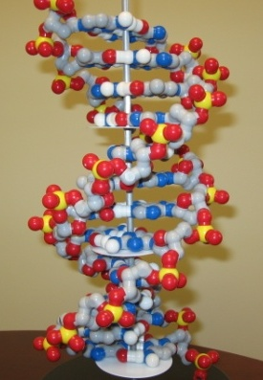
Course #1: Principles of the Biomedical Sciences
PBS Topics:
Literary research skills
Human Body Systems
Basic chemistry
Structure and function of DNA
Bioinformatics
Protein structure
Causes of infectious diseases
Grant proposals

Slide 31
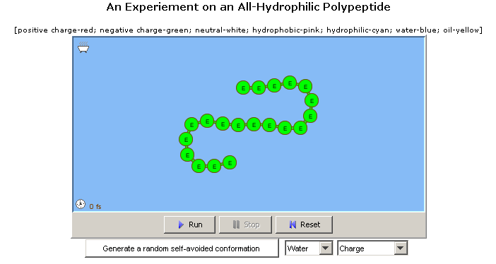
Example of a PBS Student Activity
Students use a computer simulation to view how a protein’s shape changes due to its environment and components
Example from Unit 4 in the PBS curriculum
Notes:
In this example for Principles of the Biomedical Sciences students use a computer simulation to view how protein shape is affected by its environment and by the components used to make the protein.

Slide 32
Course #2: Human Body Systems
Students study human physiology, especially in relationship to health. A central theme is how the systems work together to maintain good health.
Students use data acquisition software to monitor body functions and use the Anatomy with Clay® Manikens™ to study body structure.
Notes:
The second course, Human Body Systems™, builds on the concepts students learned in the first course and goes much more in-depth into the mechanisms that keep the body, a living machine, functioning. Students will learn how to use LabVIEW™ to write programs that allow them to collect data from the experiments they design. The focus will be on how the human body is a system that requires the coordinated actions of multiple interrelated systems, each responsible for various actions. For example, the respiratory, circulatory, digestive, and muscular systems are all coordinated to provide energy to the body from food. If a breakdown occurs in any of the systems, then the cells in the body will not have sufficient energy to survive.

Slide 33
Topics:
Course #2: Human Body Systems
Relationship between structure and function
Maintenance of health
Defense against disease
Communication within the body and with the outside world
Movement of the body and of substances around the body
Energy distribution and processing
Notes:
Topics covered in the HBS course:
Relationship between structure and function
Maintenance of health
Defense against disease
Communication within the body and with the outside world
Movement of the body and of substances around the body
Energy distribution and processing

Slide 34
Course #3: Medical Interventions
Study medical interventions involved in the prevention, diagnosis and treatment of disease as students follow the lives of a fictitious family.
Projects investigate interventions related to diagnostics, immunology, surgery, genetics, pharmacology, medical devices, and lifestyle choices.
Notes:
The third course, Medical Interventions™, allows students to investigate the wide variety of preventive and treatment actions available to prolong and improve the quality of life. Through the course they follow a fictitious family whose individual members experience a severe infectious disease leading to hearing loss, cancer, a high-risk pregnancy, and organ failure due to diabetes. Throughout the course students study pharmaceutical, surgical, genetic, and lifestyle interventions that treat or prevent a wide variety of medical diseases or conditions.

Slide 35
Topics
Course #3: Medical Interventions
Molecular biology and genetic engineering
Design process for pharmaceuticals and medical devices
Medical imaging, including x-rays, CT scans, and MRI scans
Disease detection and prevention
Rehabilitation after disease or injury
Medical interventions of the future
Notes:
Some of the topics covered in Medical Interventions are:
Molecular biology and genetic engineering
Design process for pharmaceuticals and medical devices
Medical imaging, including x-rays, CT scans, and MRI scans
Disease detection and prevention
Rehabilitation after disease or injury
Medical interventions of the future

Slide 36
Course #4: Biomedical Innovation
Students design innovative solutions for 21st century health challenges.
Students present their results to an audience which may include representatives from the healthcare or business community or the school’s PLTW partnership team.
Notes:
The fourth course is the capstone course for the program. Students will design and conduct experiments related to the diagnosis, treatment, and prevention of disease or illness. They will apply the knowledge and skills learned in the previous courses to answer questions or to solve problems related to the biomedical sciences. They may work with a mentor or have an advisor from a university, hospital, physician’s office, or industry as they complete their work. Students will be expected to make a presentation of their work to an adult audience that may include representatives from the local community or the school’s PLTW® partnership team.
This class is not an internship; students will attend a regularly scheduled class in the school to work with their teammates on the various assigned problems.

Slide 37
Biomedical Innovation
Example Problems
Design a more efficient emergency room
Design an experiment using sensors and data acquisition software to monitor or measure a physiological change
Design a medical intervention to aid patients
Evaluate water quality and propose solutions to eliminate contamination of water sources
Design a solution to a local or global public health challenge
Complete an optional independent problem
Notes:
The defined problems in the Biomedical Innovation course have students:
Design a more efficient emergency room
Design an experiment using sensors and data acquisition software to monitor or measure a physiological change
Design a medical intervention to aid patients
Evaluate water quality and propose solutions to eliminate contamination of local water sources
Design a solution to a local or global public health challenge
If the student desires, the teacher approves, and there are the school and community resources the student can work on an independent problem. This may involve working with a mentor at a university or business. It is not an internship and the student would be expected to regularly attend class.

Slide 38
Total Typical BMS Cost for the First Three Courses
Typical Non-Recurring (includes initial training for one teacher for three courses but excludes computers and facilities that most schools already have): $56,000
Typical Annual Recurring (includes typical Professional Development for replacement teachers, program fees, LabVIEW software and consumables): $7,000

Slide 39
California PLTW Partnership
Schools are supported by Regional Centers
Coordinating K-12, Community College, University, Industry and Community Groups
State Lead: San Diego State University
Regional Affiliates: SJSU, Cal Poly Pomona
Industry Partners
Funding for regional centers
Partnership Teams for individual schools
39

Slide 40
Introduction to the Engineering Pathway Chris Stinson, Antelope High School

Slide 41
Introduction to the Biomedical Pathway

Slide 42
For More Information: pltw.org pltwca.org dbcrum@live.com

